Slide 1
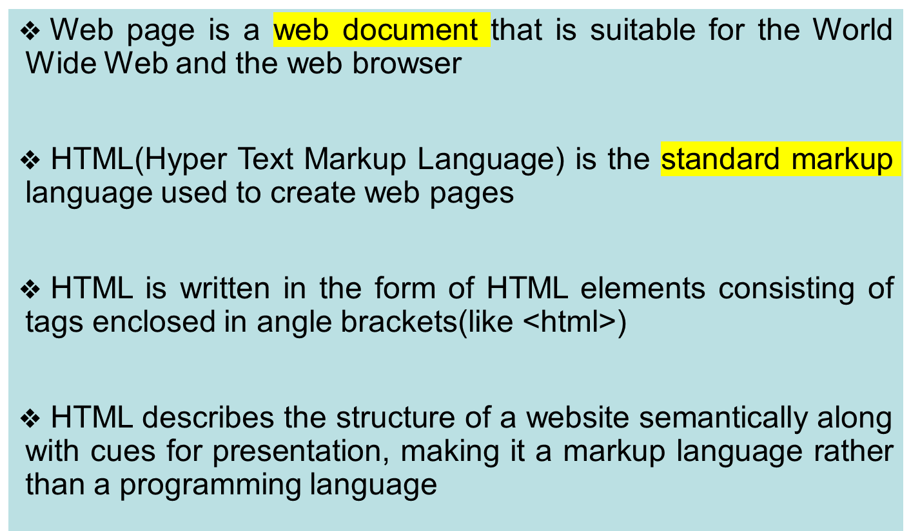
Hyper Text Markup Language-Features

Slide 2
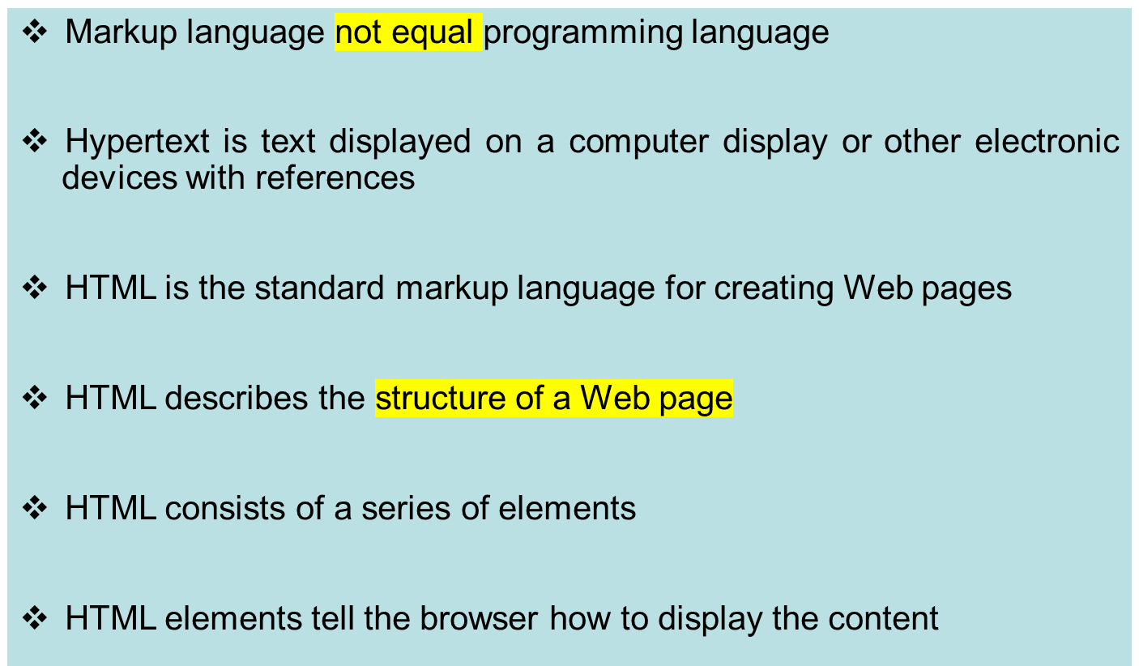
Main points

Slide 3
HTML versions
HTML 1.0. The basic version of HTML has support for basic elements like text controls and images.
HTML 2. HTML version 2.0 was developed in 1995 with basic intention of improving HTML version 1.0.
HTML 3.2. It was developed in 1997.
HTML 4.01. It was developed in 1999.
HTML5.
W3C HTML Validator.

Slide 4
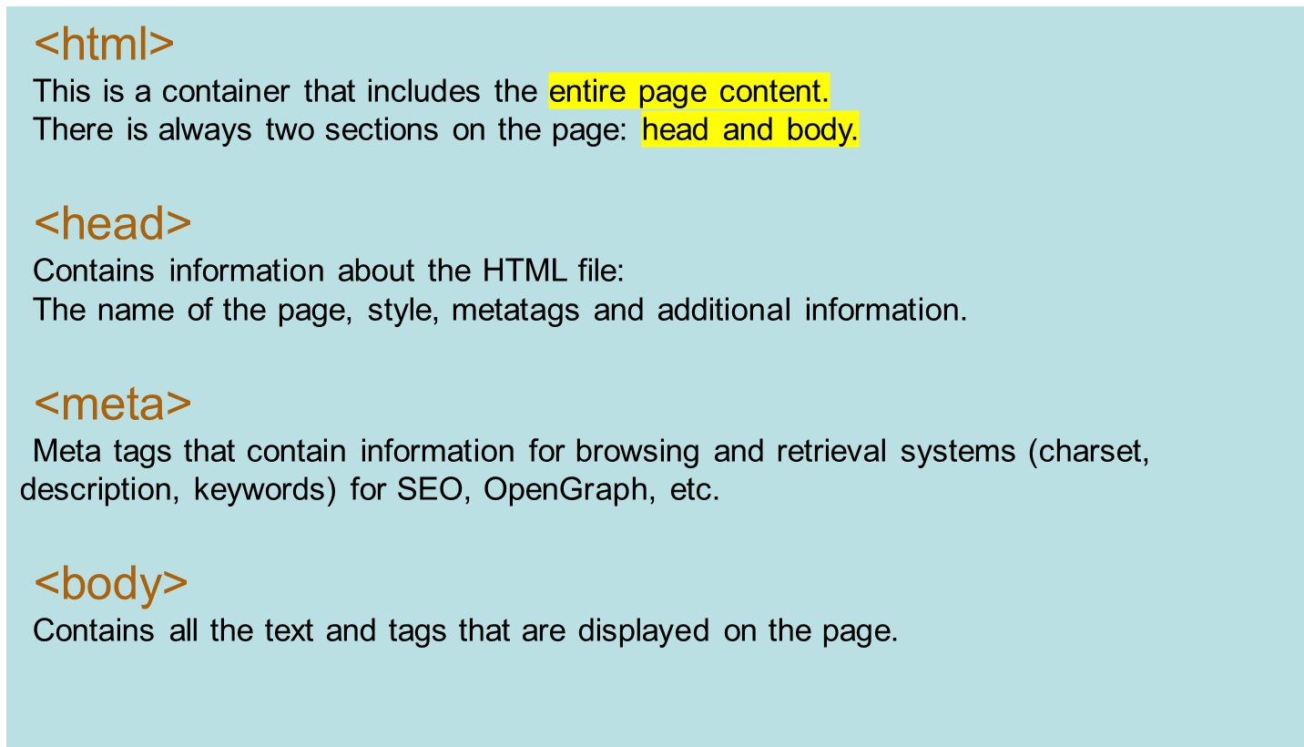
Web page structure

Slide 5
Elements of the page
Headings:
<h1>,<h2>,<h3>,<h4>,<h5>,<h6>
Some block elements:
<p>,<pre>,<address>,<blockquote>
Some inline elements:
<sub>,<sup>,<del>,<ins>,<code>,<q>,<cite>,
<big>,<small>,<b>,<strong>,<i>,<em>,<br>,<hr>

Slide 6
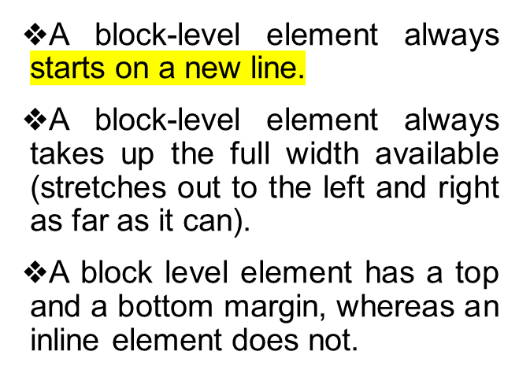

Block and Inline Elements
An inline element does not start on a new line.
An inline element only takes up as much width as necessary.

